Slide 1
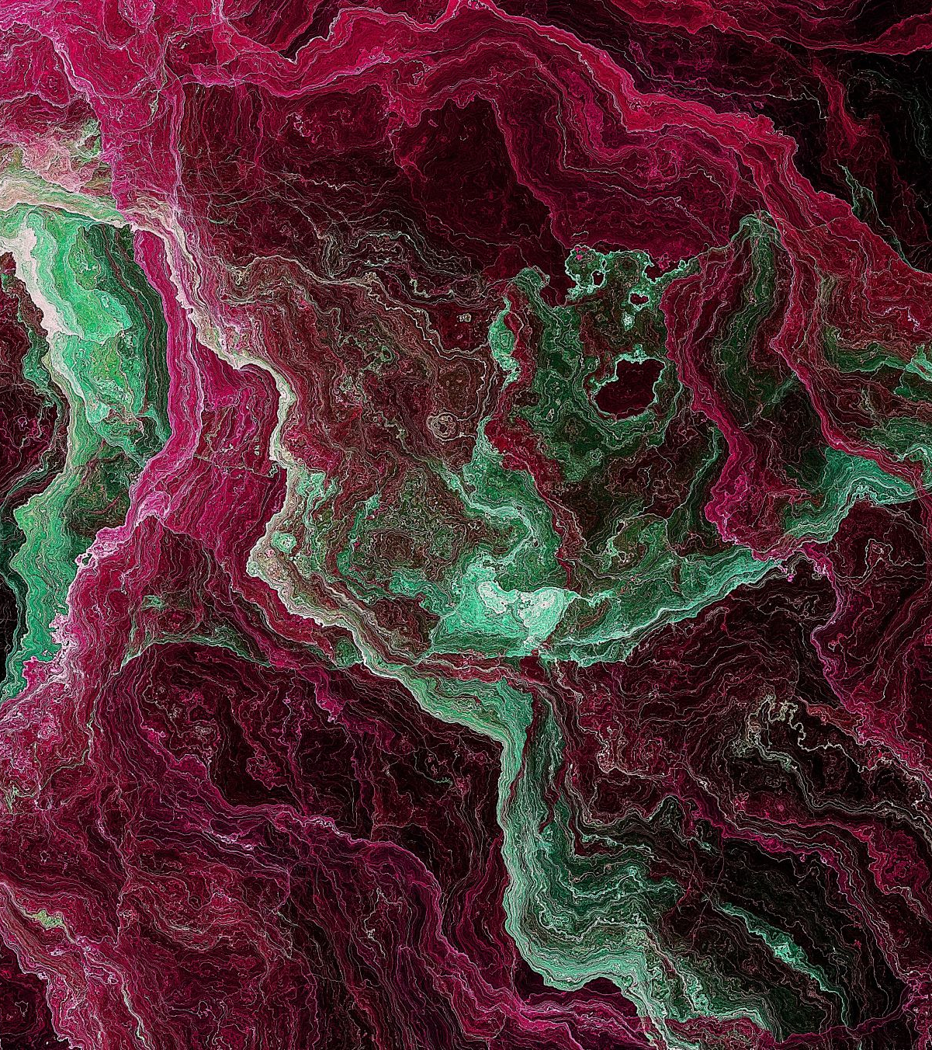
Quantum Ray Tracing
By: Hunter Mast

Slide 2
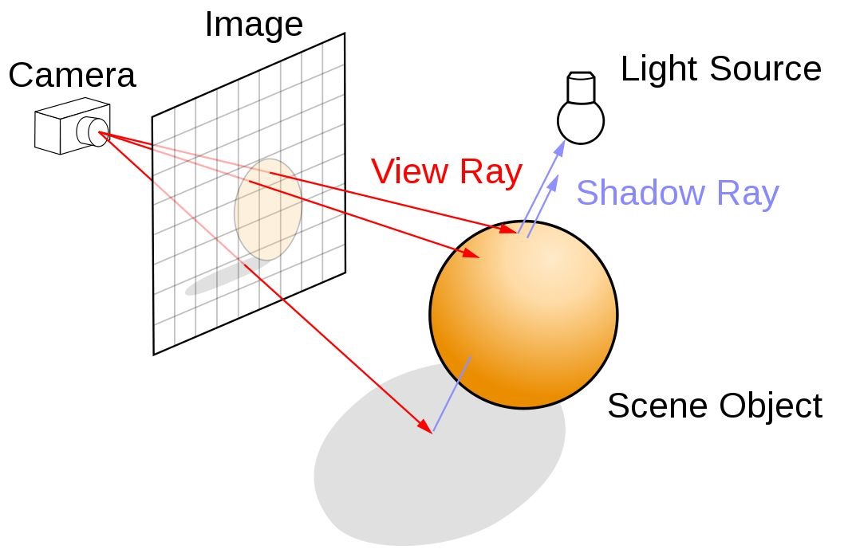
What is Ray Tracing?
Notes:
Ray tracing is a rendering technique that can simulate lighting of a scene or objects more realistically by rendering physically reflections, refractions, shadows, and indirect lighting.
The way this is done is by tracing the path of light from the camera’s view through the 2D place (Or plane of pixels) into the 3D scene and back to the source of light.
Light has to deal with multiple different kinds of interactions such as:
Shadows from the objects.
Light reflecting off of the object to other objects.
Or passing through transparent objects with refractions.
All of these interactions determine each pixel’s color that will be displayed.
It can be very computationally intensive to do all of this at once, so it focuses on one pixel at a time typically.
There are some different types that are connected to ray tracing such as:
Ray casting: The process in ray tracing that shoots 1 or more rays from the camera through each pixel in an image plane, and then tests to see if the rays intersect any primitives in the scene.
Primitive: Shape for which a ray-shape intersection routine has been written. (How rays are being created such as triangles)
Path Tracing: Higher form of ray tracing that traces many rays through each pixel and follows through each bounce off before reaching the light source to collect color and lighting information.
During this project, I focused on testing 3 different types of ray tracing to see what the differences are and how quantum computing can help us with rendering.

Slide 3
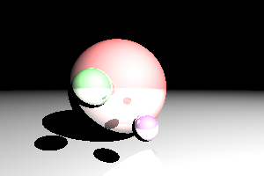
Classical RaY tRACING
Notes:
Here is an image of what I originally started with in this.
I originally tried to create a 3D environment similar to the old Doom game where we would trace the environment when moving.
Proved to be very complicated. Finished classical version, but never quantum.
Moved to static image using broken code I found on StackOverflow.
Had to fix their code by changing how light was being reflected by addition with illumination to determine pixel color, rather than multiplication.

Slide 4
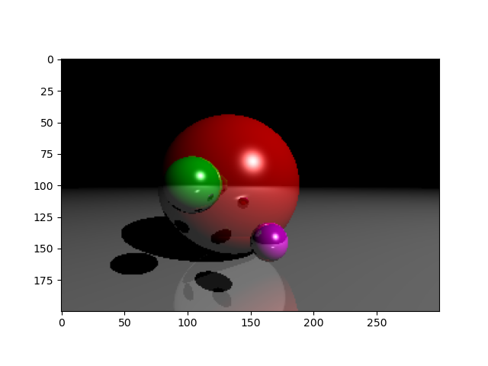
Classical RaY tRACING
Notes:
Here is what fixing said issue leaves us with.
As you can see, many of the pixels stand out and there is no “shading” in terms of diminishing pixel color.
Think of having it look almost like a gradient between contrasting colors.
In this version, we only look at each pixel once with 1 ray. There is a better way to fix though.

Slide 5

Monte Carlo Ray Tracing
Notes:
In this version, we add what we call samples to our program.
Each time we look at a pixel, we also look at N number of other pixels, or samples, randomly to determine what the color should be.
Doing this, we get an idea of what is around us and we can shade our pixel to others around it.
In contrast to the classical version, the red ball is smoother and has an overall cleaner, less pixelated look to it.

Slide 6
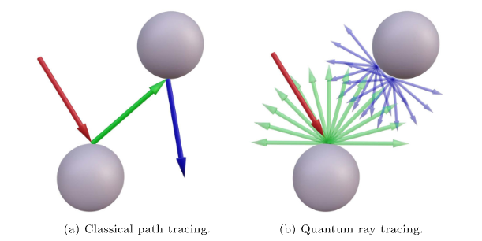
Classical Vs. Quantum Ray Tracing
Notes:
Before I get into my quantum version, I wanted to cover the basics of classical vs. quantum ray tracing.
Main difference is that classical path tracing only traces one ray at a time, while quantum ray tracing can trace numerous rays as a superposition in one shot.
Quantum ray tracing typically treats light more in terms of wave functions, rather than classical which treats it as a straight line.
Originally, I attempted to do this using a paper called Towards Quantum Ray Tracing.
This became a bit too much as much of the paper involves high-level quantum search algorithms to perform this ray tracing.
From this, I went to a simpler approach.

Slide 7
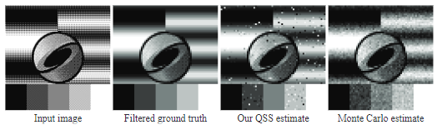
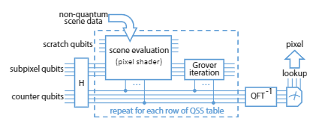
Quantum Super sampling
Notes:
There is a version of quantum ray tracing that uses something known as QSS.
Most of what I worked on with this project was focused on a paper by Eric R. Johnston called simply “Quantum Supersampling”.
In this paper, he focused on implementing a qubit-based image supersampling technique with advantages over Monte Carlo estimation.
Since I was testing with Monte Carlo, this is a good way to compare in a more hybrid manner of a classical ray tracing program with QSS elements to enhance the image.
What QSS does is that it computes a pixel value as a finite sum over subpixels.
Compare this to Monte Carlo which estimates this sum with averaging the evaluations at randomly chosen subpixel locations.
The way this is done is by taking the qubits and pixels and analyzing our data from regular ray tracing. On this, we perform what is called a Grover iteration using Grover’s algorithm.
At the end, we use inverse quantum fourier transform to estimate a value corresponding to the estimated sum with a well-defined error probability.

Slide 8
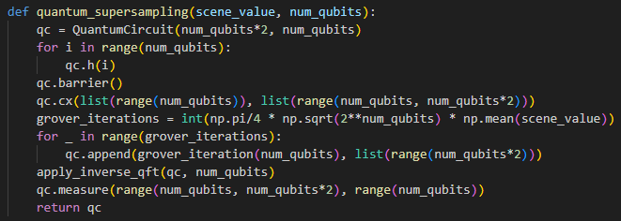
Quantum Super sampling
Notes:
Here is my basic code for my QSS. It mostly handles calling Grover’s Algorithm and Inverse QFT, but does prepare some gates and such as a Hadamard and Controlled-X gate (CNOT).
CNOT is important for Grover’s Algorithm as it allows entanglement between qubits and allows us to implement the oracle function, which is necessary for Grovers.
Barrier separates sections of the circuit for clarity.

Slide 9
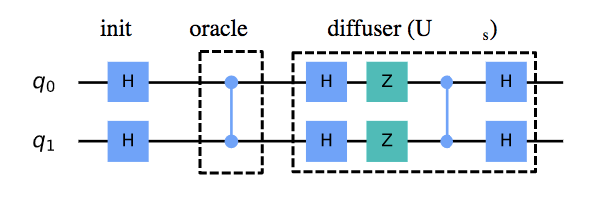
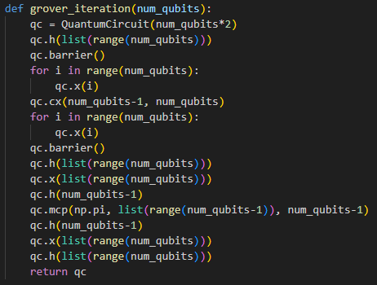
Grover’s Algorithm
Notes:
Here, we have a single iteration of Grover’s Algorithm.
Grover’s Algorithm is designed as a search algorithm for unsorted databases.
Here, it starts out with an oracle after initialization.
The oracle marks the target states in our search space. It will flip the sign of the amplitude in these target states.
After, Grover’s Algorithm performs something known as diffusion.
Diffusion is the process of amplifying the amplitude of the target states and de-amplifying the non-target states.
In our code, this would be everything after our barrier.
Overall, Grover’s goes through a bunch of possible solutions.
It has a speedup of around N items in square root of N steps, compared to classical search algorithms which are more linear.
MCP is controlled phase shift, which is needed for diffusion.
List(range(num_qubits)) is to apply the gates to all of our qubits.

Slide 10
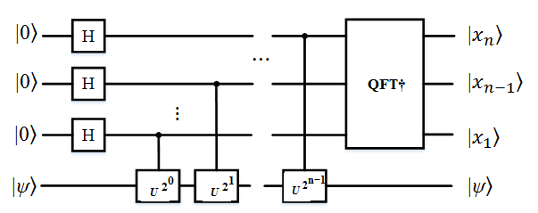
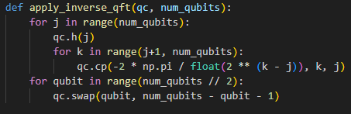
Inverse Quantum Fourier Transform
Notes:
After Grover’s we perform inverse QFT.
This is just QFT, but in reverse.
We apply a series of Hadamard gates to create a superposition of all possible states.
Then, we use controlled phase shift gates to determine each qubit’s position.
Finally, we reorder the gates depending on how it should be read out.
We mostly use this as we need to get our value for the estimated sum by phase estimation.
Phase estimation is us trying to estimate the optimal number of iterations required to achieve the maximum probability from a target state.
In this case, we do this to finish out Grover’s and get the value of our pixel.

Slide 11
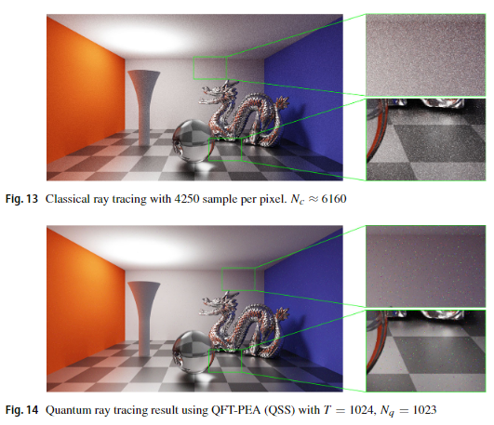
Quantum Super sampling
Notes:
Here is a higher-level result of using QSS compared to classical.
Overall, we reduce the noise of the image and can provide a clear image.

Slide 12
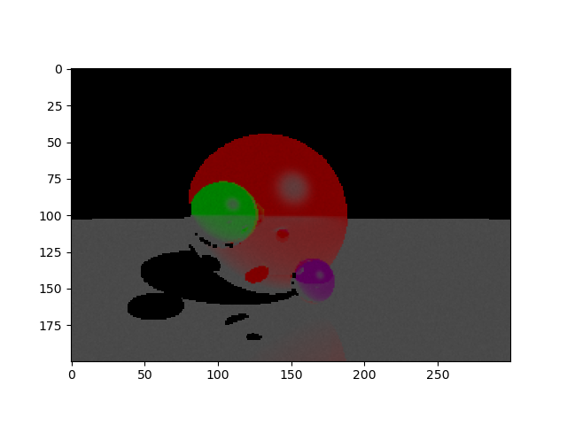
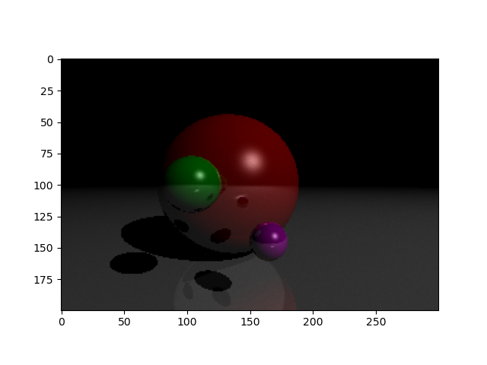
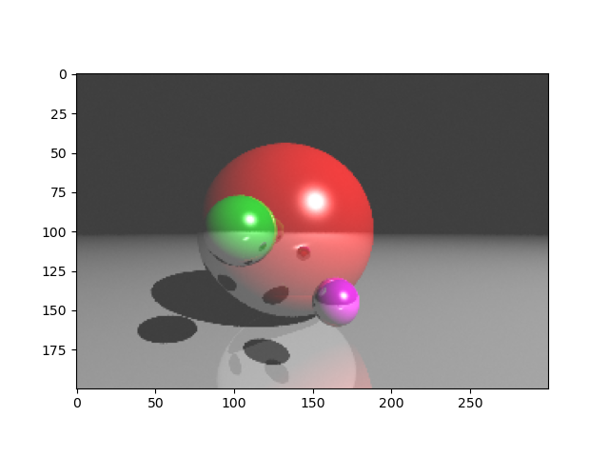

Quantum Ray Tracing
Notes:
For my QSS, I ended up with the following results.
The 1st one was me testing around with getting the circuit prepared. I had not added Grover’s yet, so it produced something similar to this.
In the second, I had messed up lighting, so the pixels always appeared darker.
After fixing that, we got to a really close version. The issue I found was that I did not reduce noise of the image at all.
Noise comes from the quantum circuit with errors in the gates, how much we sample, etc.
The color of each pixel is estimated by converting our quantum estimation to a color code for the pixel in a classical sense.
With it, it was producing the result of [0.5, 0.5, 0.5] when it should have been completely black, or [0, 0, 0].
I accidently set this value to be reduced by the number of qubits, not the number of samples for quantum super sampling.
Fixing this, each color value was reduced more depending on the number of samples.
The final image is a correct working version with 10 samples being used.

Slide 13

Quantum Ray Tracing
Notes:
Here is a version using 50 samples, similar to Monte Carlo, but not much of a difference between the 10 samples and 50 other than 50 is slightly higher quality.
I mostly focused on looking at the 10 sample image but I did want to show this.

Slide 14
Comparison
Notes:
QSS advantages over Monte Carlo:
Lower average pixel error for the same number of subpixel evaluations.
Increased number of error-free pixels.
Subpixel is a smaller pixel than what is being displayed.

Slide 15
Comparison

Slide 16
Comparison
Classical:
20 Seconds. (0 Samples)
Monte Carlo:
11.34 Minutes. (50 Samples)
Quantum Super Sampling:
5.6 Hours (10 Samples).
26.41 Hours (50 Samples).
Notes:
The results show that QSS was very, very slow in comparison to Monte Carlo, but I would argue that in theory, it should be faster if we were using a quantum computer to handle much of the computation.
There is also most likely some way to optimized my QSS, but I didn’t focus on that too much.

Slide 17
Sources
https://www.reddit.com/r/raytracing/comments/rv1er1/sample_per_pixel_and_ray_per_pixel_in_ray_and/
https://developer.nvidia.com/discover/ray-tracing
https://stackoverflow.com/questions/75277849/raytracing-in-python
Santos, Luís Paulo, et al. “Towards Quantum Ray Tracing.” IEEE Transactions on Visualization and Computer Graphics, 2024, pp. 1–12, https://doi.org/10.1109/tvcg.2024.3386103.
Lu, Xi, and Hongwei Lin. “Improved quantum supersampling for Quantum Ray Tracing.” Quantum Information Processing, vol. 22, no. 10, 28 Sept. 2023, https://doi.org/10.1007/s11128-023-04114-x.
Johnston, Eric R. “Quantum Supersampling.” ACM SIGGRAPH 2016 Talks, 24 July 2016, https://doi.org/10.1145/2897839.2927422.

